Slide 1

Object Communication and Events
Software University
http://softuni.bg
SoftUni Team
Technical Trainers

Slide 2
Table of Contents
Delegates
Events
Events vs Delegates
EventHandlers
Custom Events
Observer Pattern

Slide 3
Questions
sli.do #fund-csharp

Slide 4
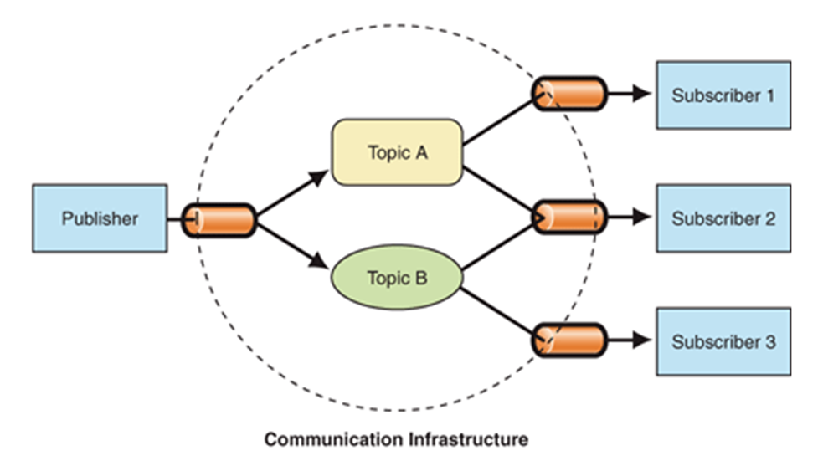
What are Delegates?

Slide 5
What are Delegates?
Delegate is a C# type that represents a method reference
A data type holding a function (method) as its value
Describes the parameter list and return type (method signature)
Delegates are similar to function pointers in C and C++
In JavaScript any variable can hold a function

Slide 6
Creating Delegates
Custom delegates are defined using the delegate keyword:
public delegate void WorkPerformedHandler
(int hours, WorkType workType)
public void ManagerWorkPerformed
(int workHours, WorkType wType)
Must be mimicked by a handler method

Slide 7
What is a Multicast Delegate?
Can reference more than one delegate function
Tracks delegate references using an invocation list
Delegates in the list are invoked sequentially
Delegate
+Method
+Target
-_invocationList
MulticastDelegate
Custom Delegate

Slide 8
Creating a Delegate Instance
public delegate void WorkPerformedHandler
(int hours, WorkType workType);
WorkPerformedHandler dele =
new WorkPerformedHandler(WorkPerformed);
static void WorkPerformed(int hours, WorkType workType)
{
Console.WriteLine("WorkPerformed called " +
hours.ToString());
}
Delegate
Instance
Handler

Slide 9
Assigning a Lambda to a Delegate
Lambda expressions can be assigned to any delegate
public delegate int AddDelegate(int a, int b);
public static void Main()
{
AddDelegate ab = (a, b) => a + b;
int result = ab(1, 1);
//result = 2
}

Slide 10
Delegate Operations
Invoke
Add to the invocation list
WorkPerfHandler dele =
new WorkPerfHandler(WorkPerformed);
dele(5, WorkType.Golf);
var first = new WorkPerfHandler(WorkPerformed);
var second = new WorkPerfHandler(WorkPerformedSecond);
first += second;
first(5, WorkType.Golf);

Slide 11
Delegates Constraints
Can point to static and instance methods
Can point to a sequence of multiple methods
Used to perform callbacks invocations
Used to implement the "publish-subscribe" model
Components publish their events
E.g. Button publishes Click and MouseOver events
Other components subscribe to events
E.g. LoginForm subscribes to LoginButton.Click

Slide 12
Delegates Example
static void DoWork(WorkPerformedHandler del)
{
del(5, WorkType.Golf);
}
static void WorkPerformed(int hours, WorkType workType)
{
Console.WriteLine("WorkPerformed " + hours.ToString()
+ " hours of " + workType);
}
//TODO: Implement same logic in next two methods:
//WorkPerformedSecond(int hours, WorkType workType)
//WorkPerformedThird(int hours, WorkType workType)
Notes:
Extensibility / Polymorphism: New functionality may be easily plugged in without changing existing classes as long the new plug-in classes extend given base classes.
Reusability: For a set of similar applications a framework can be defined using a core set of classes that are to be extended by classes that fill in the application-dependent part.
Information Hiding: If a more general class using a simpler contract is sufficient, details from extending classes may be hidden to some of the client classes. This allows them to be more independent from possible changes and diminishes the load of contracts that must be understood by a reader of these client classes.
(c) 2006 National Academy for Software Development - http://academy.devbg.org*
12##

Slide 13
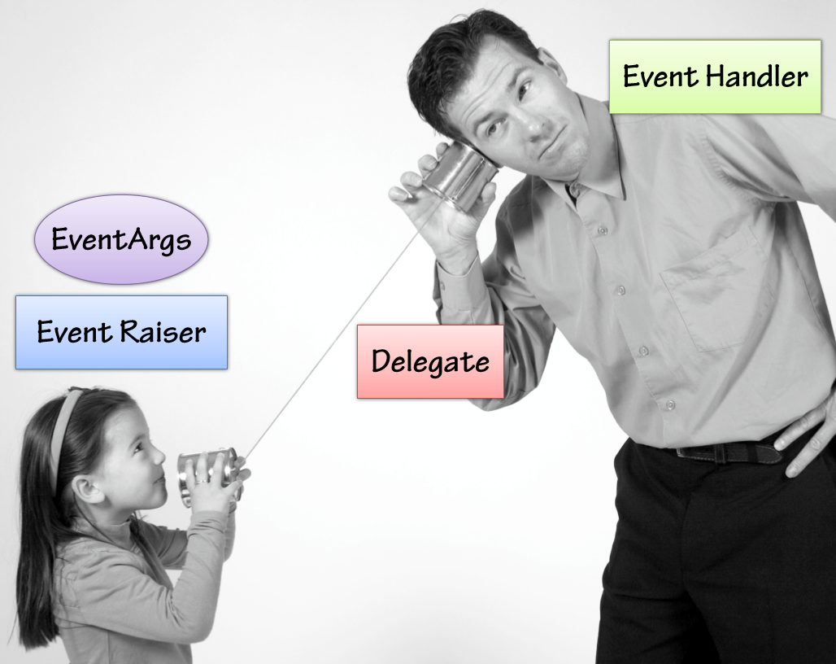
Events
Overview

Slide 14
What are Events?
Events are notifications
Play a central role in the .NET world
Provide a way to trigger notifications from end users or from objects

Slide 15
What are Events?
Events signal the occurrence of an action/notification
Objects that raise events don’t need to explicitly know the object that will handle the event
Events pass EventArgs(event data)
Button
Click Event

Slide 16
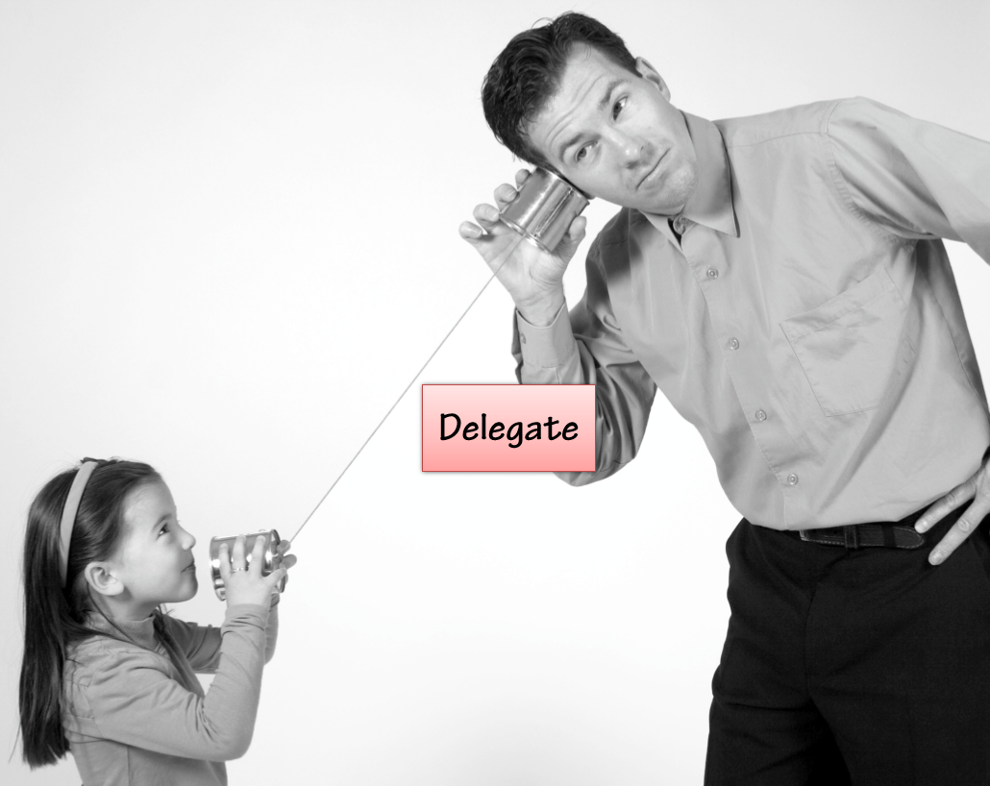
What is a Delegate?
A delegate is a specialized class often called a "Function Pointer"
The glue/pipeline between an event and an event handler
Based on a MulticastDelegatebase

Slide 17
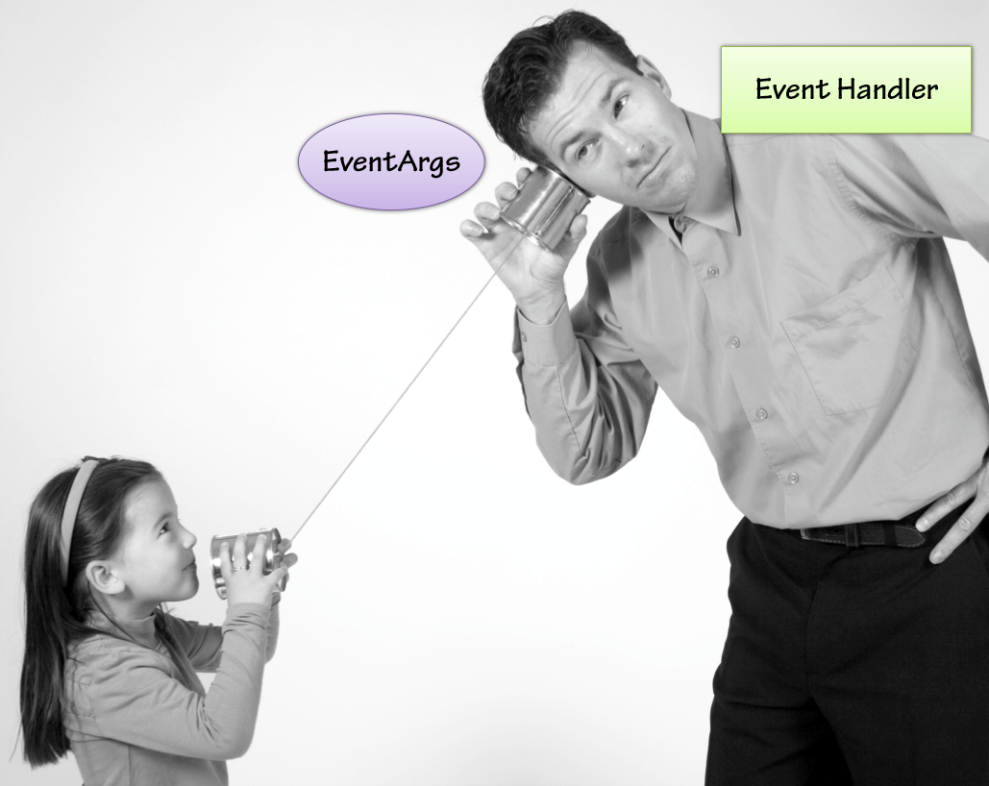
What is an EventHandler?
Event handler is responsible for receiving and processing data from a delegate
Normally receives two parameters:
Sender
EventArgs
EventArgs responsible for encapsulating event data

Slide 18
Events
In component-oriented programming components publish events to other components
Events notify that something has happened
The object which causes an event is called event sender
The object which receives an event is called event receiver
In order to receive an event, the event receivers should first "subscribe to the event"
Notes:
In component-oriented programming components publish events to other components
Events notify that something has happened
E.g. moving the mouse causes an event
The object which causes an event is called event sender
The object which receives an event is called event receiver
In order to receive an event, the event receivers should first "subscribe to the event"

Slide 19
Defining an Event
Events in C# are special delegate instances declared by the keyword event
+= subscribes for an event
-= unsubscribes for an event
public event WorkPerformedHandler WorkPerformed;
public event EventHandler WorkCompleted;
Notes:
Events in .NET
Events in C# are special delegate instances declared by the keyword event
In the component model of .NET the
subscription
sending
receiving
of events is supported through delegates and events

Slide 20
Raising an Event
Events are raised by calling the event like a method:
Or access the event’s delegate and invoke it directly:
if (WorkPerformed != null)
WorkPerformed(8, WorkType.GenerateReports);
WorkPerformedHandler del =
WorkPerformed as WorkPerformedHandler;
if (del != null)
del(8, WorkType.GenerateReports);
Notes:
Events in .NET
Events in C# are special delegate instances declared by the keyword event
In the component model of .NET the
subscription
sending
receiving
of events is supported through delegates and events

Slide 21
Events vs. Delegates
Events can be members of an interface - Delegates cannot
An event can only be called in the class where it is defined
By default the access to the events is synchronized (thread-safe)
public Action<string> m;
≠
public event Action<string> m;
Notes:
Events vs Delegates
Events are not the same as member fields of type delegate
public Action<string> m; ≠ public event Action<string> m;
Events can be members of an interface
Delegates cannot be members of an interface
An event can only be called in the class where it is defined
By default the access to the events is synchronized (thread-safe)

Slide 22
Exposing and Raising Events
public delegate void WorkPerfHandler (int hours, WorkType workType);
public class Worker
{
public event WorkPerfHandler WorkPerformed;
public virtual void DoWork(int hours, WorkType workType)
{
// Do work here and notify consumer that work has been performed
OnWorkPerformed(hours, workType);
}
//TODO: Add method for raising event (next slide)
}

Slide 23
Exposing and Raising Events (2)
protected virtual void OnWorkPerformed(int hours, WorkType workType)
{
WorkPerfHandler del = WorkPerformed as WorkPerfHandler;
if (del != null) //Listeners are attached
{
del(hours, workType);
}
}

Slide 24
Custom Events: Convention
No return value
Delegate name: Verb + EventHandler
public delegate void ItemChangedEventHandler(
object sender, ItemChangedEventArgs eventArgs);
Event sender is System.Object
Event information is inherited from System.EventArgs
Notes:
Custom Events: Convention
.NET defines a convention (pattern) for defining events:
http://msdn.microsoft.com/en-us/library/aa645739(v=vs.71).aspx
Delegates which are used for events:
Have names formed by a verb + EventHandler
Accept two parameters:
Event sender – System.Object
Event information – inherited from System.EventArgs
No return value (void)

Slide 25
Custom Events: Convention (2)
Follow PascalCase naming convention
Events are declared public
public event ItemChangedEventHandler ItemChanged;
End with a verb
Notes:
Custom Events: Convention (2)
Example:
public delegate void ItemChangedEventHandler(
object sender, ItemChangedEventArgs eventArgs);
Events:
Are declared public
Follow PascalCase naming convention
End with a verb
For example: public event ItemChangedEventHandler ItemChanged;

Slide 26
Custom Events: Convention (3)
To raise an event a special protected void method is created
Named after a specific action, e.g. OnVerb()
The receiver method (handler) is named in the form OnObjectEvent:
protected void OnItemChanged()
{
…
}
private void OnOrderListItemChanged()
{
…
}
Notes:
Custom Events: Convention (3)
To fire an event a special protected void method is created
Named after a specific action, e.g. OnVerb()
protected void OnItemChanged()
{
…
}
The receiver method (handler) is named in the form OnObjectEvent:
private void OnOrderListItemChanged()
{
…
}

Slide 27
EventArgs
The EventArgs class is used in the signature of many delegates and event handlers:
When custom data needs to be passed the EventArgs class can be extended.
public delegate void EventHandler
(object sender, EventArgs e);
public event EventHandler<EventArgs> WorkPerformed;
Notes:
The System.EventHandler Delegate
System.EventHandler defines a reference to a callback method, which handles events
No additional information is sent about the event, just a notification:
public delegate void EventHandler(object sender, EventArgs e);
Used in many occasions internally in .NET
The EventArgs class is the base class with no information for the event

Slide 28
Deriving from the EventArgs Class
To use a custom EventArgs class, the delegate must reference the class in its signature
public class WorkPerformedEventArgs : EventArgs
{
public int Hours { get; set; }
public WorkType WorkType { get; set; }
}
public delegate void WorkPerfHandler
(object sender, WorkPerfEventArgs e)

Slide 29
Defining and Attaching Event Handlers
The += operator is used to attach an event to an event handler:
var worker = new Worker();
worker.WorkPerformed +=
new EventHandler<WorkPerfEventArgs>(worker_WorkPerformed);
Compiler will “infer” the delegate
var worker = new Worker();
worker.WorkPerformed += worker_WorkPerformed;
void worker_WorkPerformed(object sender, WorkPerfHandler e)
{
Console.WriteLine(e.);
}

Slide 30
Anonymous Methods
Anonymous methods allow event handler code to be hooked directly to an event
Anonymous methods are defined using the delegate keyword
var worker = new Worker();
worker.WorkPerformed +=
delegate(object sender, WorkPerfEventArgs e)
{
Console.WriteLine(e.Hours.ToString());
};
//End of anonymous method

Slide 31
UI Mouse Click Event Handler – Example
public partial class MainWindow : Window
{
public MainWindow()
{
this.InitializeComponent();
this.MouseDown += this.MainWindow_MouseClick;
}
private void MainWindow_MouseClick(object sender,
MouseButtonEventArgs e)
{
MessageBox.Show(string.Format("Mouse clicked at ({0}, {1})",
e.MouseDevice.GetPosition(this).X,
e.MouseDevice.GetPosition(this).Y));
}
}
Receives info about the click as MouseButtonEventArgs

Slide 32
Event Loop
Wait for events
Handle events
Notes:
Event Loop
UI technologies usually have an event loop running
Waits for events from the underlying operating system and notifies the respective components
while (message != "quit")
{
// Blocking operation - waits for an event from OS
message = GetMessage();
ProcessMessage(message);
}

Slide 33
Event Loop – Simple Example
while (message != "quit")
{
// Blocking operation waits for an event from OS
message = GetMessage();
ProcessMessage(message);
}
Notes:
Event Loop
UI technologies usually have an event loop running
Waits for events from the underlying operating system and notifies the respective components
while (message != "quit")
{
// Blocking operation - waits for an event from OS
message = GetMessage();
ProcessMessage(message);
}

Slide 34

Observer
Handle Events

Slide 35
Observer Design Pattern
Define a one-to-many relationship
Update observers once an event in the subject occurs
Subject subject = new Subject();
subject.addObserver(new Observer());
subject.addObserver(new Observer());
// observers are notified after a state change

Slide 36
Observer – UML
Subject, Observer
ConcreteObserver
Subject
-ObserverCollection
+registerObserver(Observer)
+notifyObservers()
Observer
+notify()
ConcreteObserver
ConcreteObserver

Slide 37
Problem: Observer
Implement the following:
interface ISubject
void Register(IObserver)
void Unregister(IObserver)
void NotifyObservers()
interface IObserver
Update(int)
If a Target dies, it should send reward to all of its Observers

Slide 38
Solution: Observer
public interface Subject
{
void Register(IObserver observer);
void Unregister(IObserver observer);
void NotifyObservers();
}
public interface Target : Subject
{
…
}
This is violation of ISP, find a better solution

Slide 39
Solution: Observer
public interface Observer
{
void Update(int val);
}
public class Hero : Attacker, Observer
{
// implementation
}

Slide 40
Solution: Observer
public void Register(IObserver observer)
this.observers.Add(observer);
public void Unregister(IObserver observer)
this.observers.Remove(observer);
public void NotifyObservers()
{
foreach (IObserver observer in observers)
{
observer.Update(this.reward);
}
}
Add methods to Dragon implementation

Slide 41

Summary
…
…
…
A delegate is a specialized class often called a "Function Pointer"
Events are a way for an object to broadcast that something has happened
When an event "happens", all subscribers are notified
Observer pattern

Slide 42
https://softuni.bg/courses/csharp-oop-advanced

Slide 43













SoftUni Diamond Partners

Slide 44





SoftUni Organizational Partners

Slide 45




Trainings @ Software University (SoftUni)
Software University – High-Quality Education and Employment Opportunities
softuni.bg
Software University Foundation
http://softuni.foundation/
Software University @ Facebook
facebook.com/SoftwareUniversity
Software University Forums
forum.softuni.bg

Slide 46

License
This course (slides, examples, demos, videos, homework, etc.) is licensed under the "Creative Commons Attribution-NonCommercial-ShareAlike 4.0 International" license

